Slide 1
IPVideoTalk Web Meetings
Grandstream Web & Video Conferencing Platform
proprietary & confidential
9/3/2015

Slide 2

IPVideoTalk
Video, Audio and Web Conferencing Service
  What is it?
  Grandstream’s hosted video, audio and web conferencing service that allows users to join meetings from anywhere
  WebRTC based platform features 1-click meeting joining from Chrome, Firefox and Opera browsers (plug-in for Safari and internet explorer)
  Join meetings from a PC, Mac, Android or iOS device
  Also available as a hosted service to be used with Grandstream’s GVC3200 and GVC3202 video conferencing hardware

Slide 3
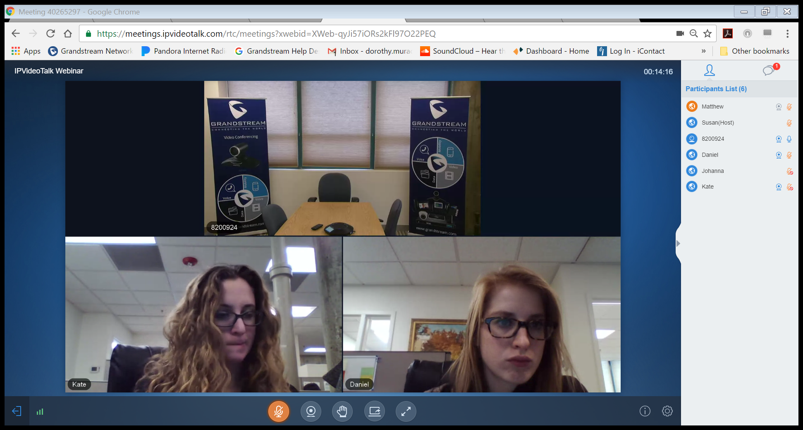


IPVideoTalk Web Meetings – Free Personal Plan
  IPVideoTalk offers a free Personal Web Meetings plan – the first web meetings plan prior to the expanded plans due later this year
  The plan includes:
    3 video feeds
    3 participants (standard meeting)
    50 participants for webinar meeting (trial)
    720p HD video resolution
    2-way video
    Screen sharing
    Free Android and iOS apps
    1-click, WebRTC powered meetings
    Maximum meeting time – 60 minutes
Kate
Daniel

Slide 4

Why IPVideoTalk?
General Advantages: Functionality
  One click meeting joining using a WebRTC-capable browser
  HD 720p Video
  HD Audio
  Screen Sharing via browser or IPVideoTalk app
  Join with or without hardware – options to use IPVideoTalk Web Meetings, or Room System plans based on their needs
  Webinar Features – always included without the need for additional fees or add-ons

Slide 5
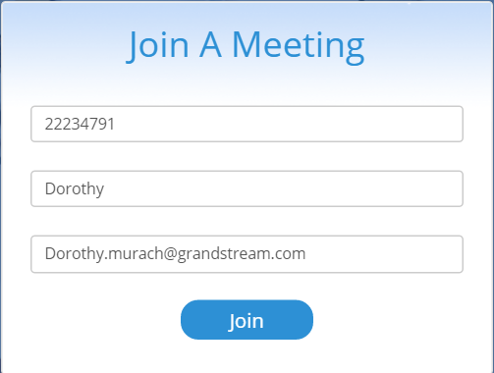
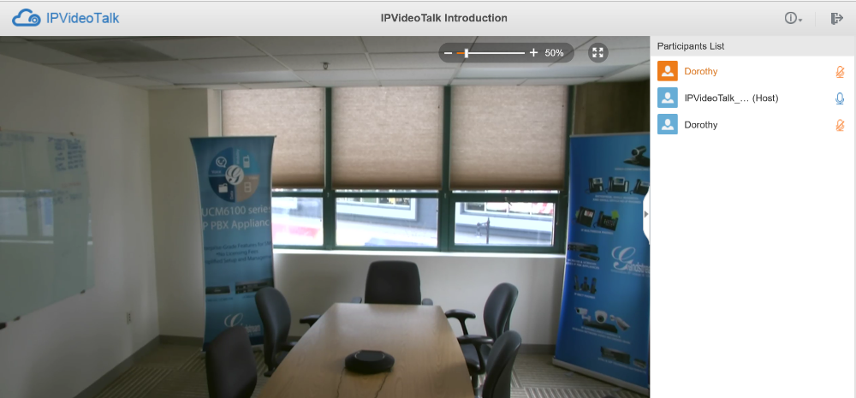

Join Meetings in 1-Click
  Join a meeting in 1-click when using a WebRTC capable browser
  Supported via Firefox, Chrome and Opera browsers (Safari and Internet Explorer browsers require a plug-in)
  Compatible on both PC and Mac computers

Slide 6
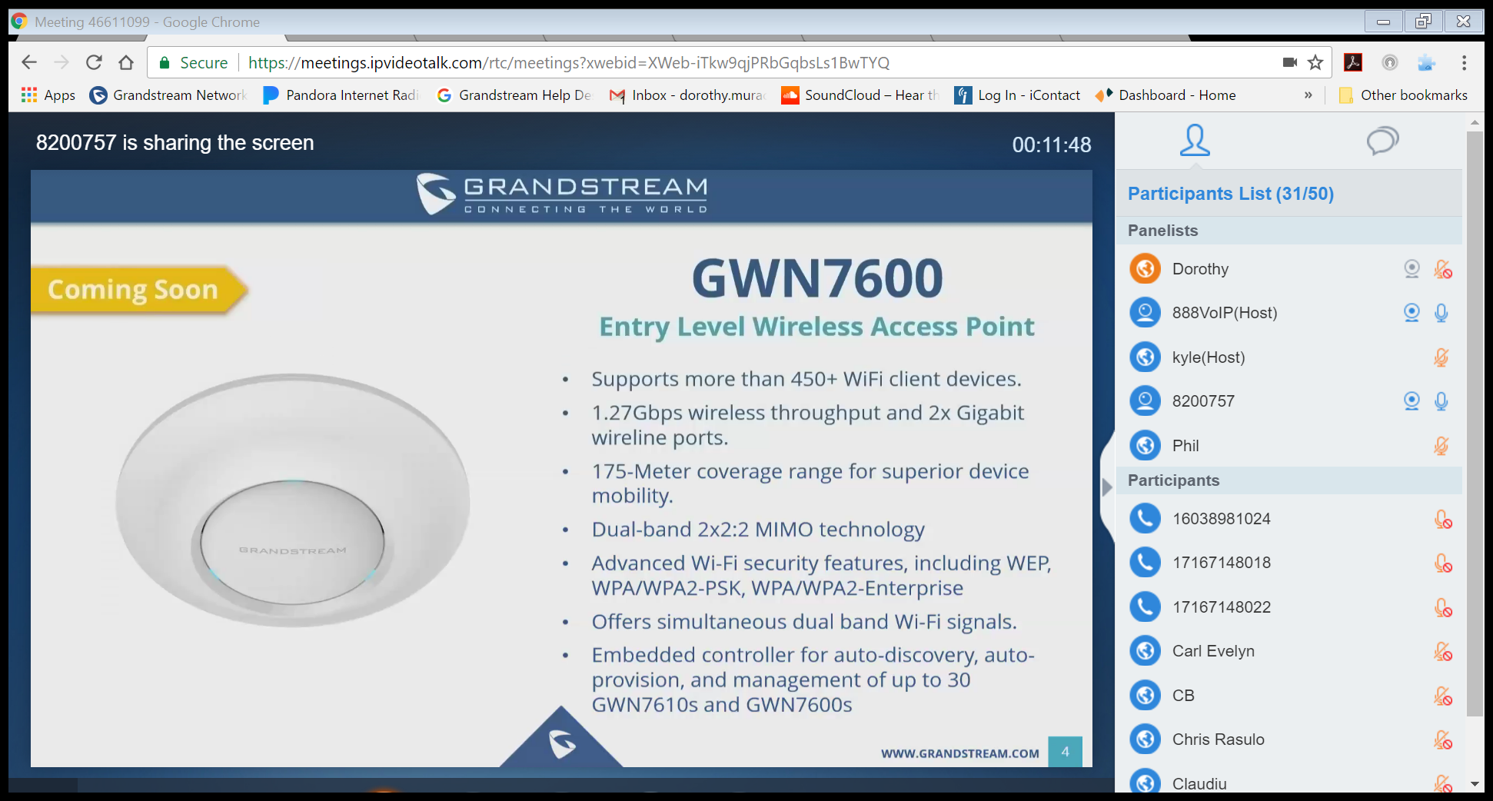

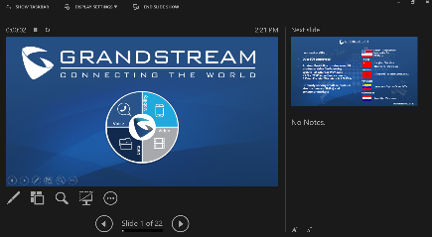

Screen Sharing
Andy
  Present and collaborate by sharing your screen with meeting participants
  Screen sharing is available from any browser or through the IPVideoTalk app for Android an iOS
Michael

Slide 7

Full HD Video Quality
  Hold more efficient and productive meetings with high-quality video
  720p HD video resolution for attendees
  Flexible resolution rates to accommodate varying network conditions (Auto, HD and SD)

Slide 8

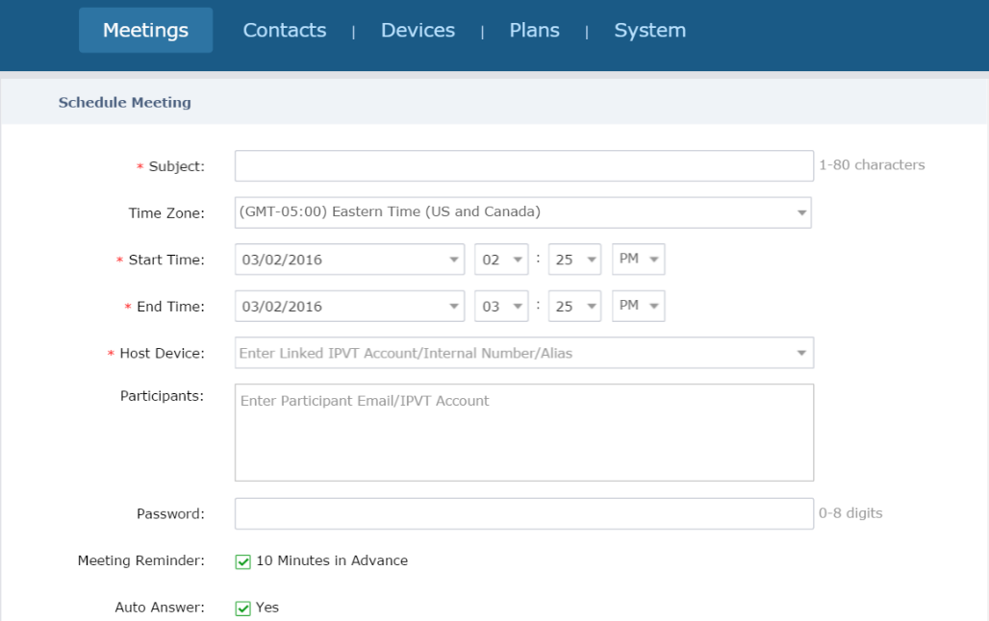

Conference Scheduling
Plan/Start Meetings
View Schedules
Meeting Reminders
Host Meeting Controls

Slide 9

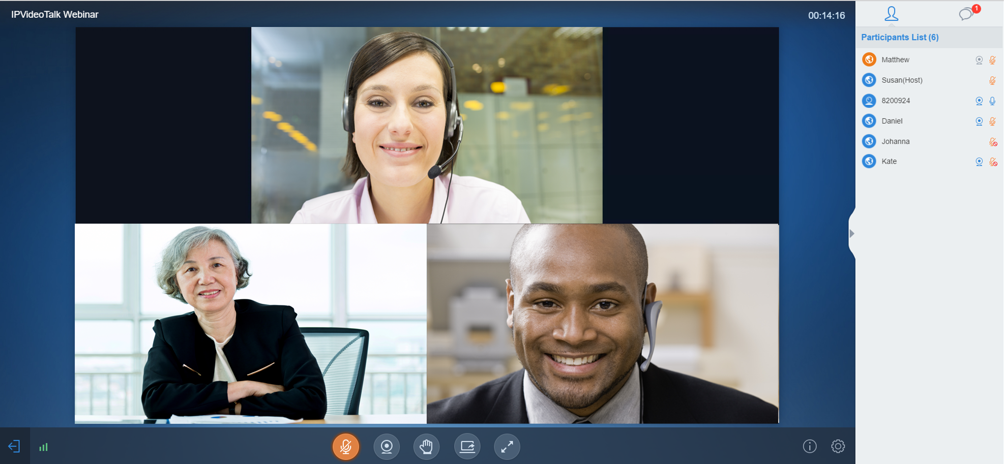


2 Way-Video
on Google Chrome and Firefox
2-way video using WebRTC browsers
(Google Chrome, Firefox, Opera)
Join a meeting from your PC or Mac laptop or desktop computer
Enjoy up to 720p on most PCs

Slide 10




Easy Accessibility
Connect from anywhere
Participate in any meeting from your mobile Android or iOS device.
HD Voice and Video
Screen-sharing for enhanced collaboration
Chat with other meeting participants

Slide 11
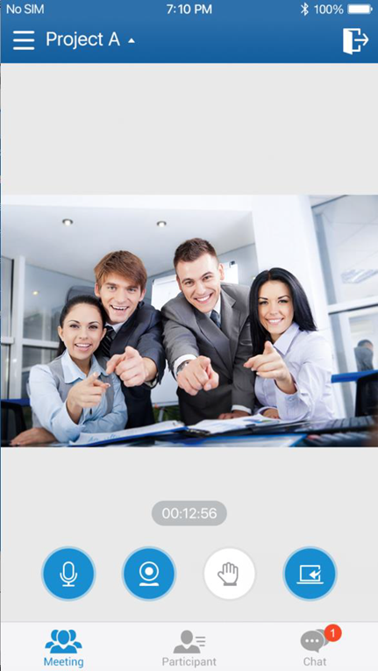
2-Way video support for Mobile App
(iOS, Android)
  Available on Google Play and iTunes Store
  Can be used with smart phones or tablets
  Ability to choose which camera to Share (Front, Rear cameras)
  Landscape mode support, and sleek design

Slide 12
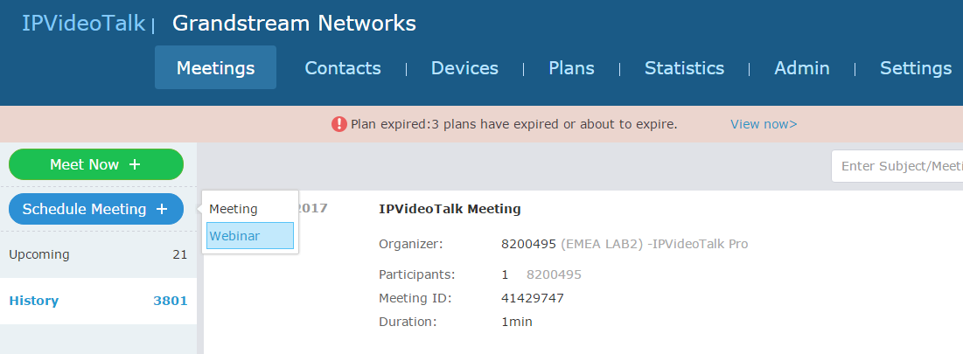
Webinar Mode
  Admins can choose between two modes for scheduling: Meeting and Webinar.
  Intuitive design, quick and easy to setup.
  Webinar mode offers both “host” and “panelist” distinctions
  Panelists have more options and control over the webinar (second to the host).

Slide 13
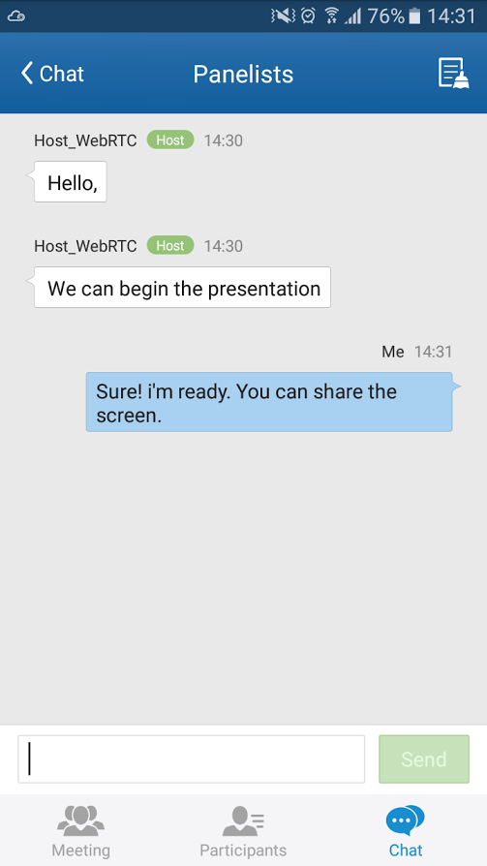
Webinar Mode-Panelist Role
  Private chat room for Panelists (not visible to standard participants).
  Ability to coordinate between different panelists and hosts.
  Hosts can assign Panelist role to any standard participant during the meeting to gain more options.
  Panelists can control their own audio, video and screen sharing (standard attendees cannot)

Slide 14
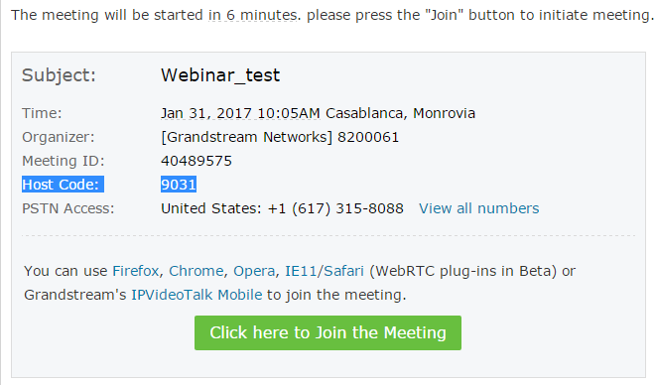
Webinar Mode - Multiple Host and Panelist Support
  Ability to have multiple hosts in the same meeting.
  Giving more control and monitoring over the meeting
  More coordination and collaboration between hosts
  Hosts have the highest privilege and control over the meeting (End Meeting, Request Camera Sharing, Muting/Unmuting for a participant, Remove a Participant, Disable/Enable Chat…and more)

Slide 15
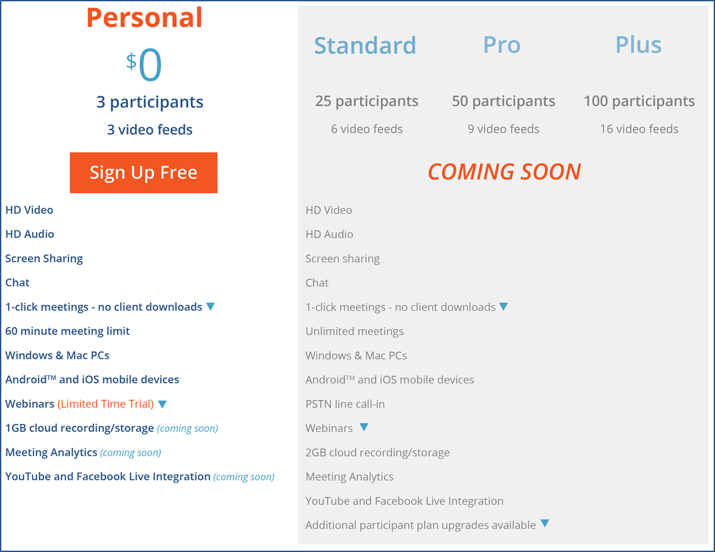
Plan Information & Pricing
Coming Soon
  Free Personal plan available now
  Expanded plans available during Summer 2017
  All plan versions will be available to use with GVC video conferencing hardware

Slide 16
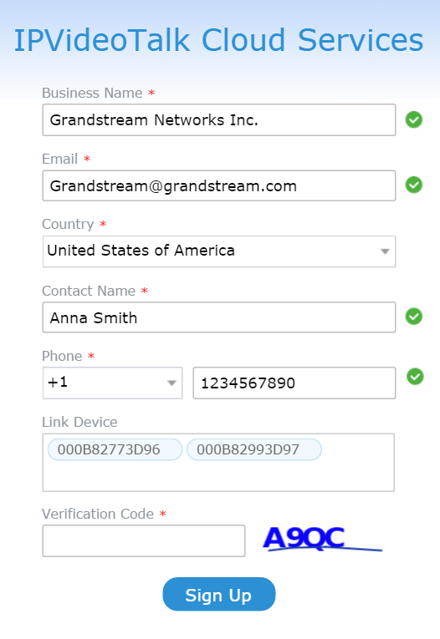
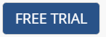
How to Sign Up
  Visit ipvideotalk.com
  Click “Free Trial” in the top right corner
  Enter your business and contact information
  (exclude “Link Device”, this is for Room System Use Only)
  Enter the Verification Code
  Click “Sign Up”, verify your account via email
  Start your first meeting!

Slide 17
Thank You!
CORPORATE HEADQUARTERS
126 Brookline Ave, 3rd Floor
Boston, MA 02215
Voice: +1 617-566-9300
Fax: +1 617-249-1987
www.grandstream.com

Slide 18
OFFICE LOCATIONS
NORTH AMERICA
Corporate Headquarters
126 Brookline Ave, 3rd Floor
Boston, MA 02215
Voice: +1 617-566-9300
Fax: +1 617-249-1987
Los Angeles
1208 John Reed Court
City of Industry, CA 91745
Voice: +1 626-638-9172
Fax: +1 617-249-1987
Dallas
2301 W. Plano Pkwy Suite 208
Plano, TX 75075
Voice: +1 469-241-0100
Fax: +1 617-249-1987
EUROPE, MIDDLE EAST & AFRICA
Casablanca, Morocco
ASIA
Shenzhen, China
Hangzhou, China
Petaling Jaya, Malaysia
SOUTH AMERICA
Valencia, Venezuela
www.grandstream.com

